Slide 1
Clustering neighborhoods in Ho Chi Minh city (Viet Nam)
IBM final capstone project

Slide 2
1. Introduction: Business problem
Business problem:
Currently I live in Distric 9 (Wards/Neighborhoods: Phuoc Long B, district 9, Ho Chi Minh city, Viet Nam). I will move to another location in distric 9 or Ho Chi Minh city in the future depend on my new job, so I 'd like to know:
Which neighborhoods in district 9 are similarities to where I live (about utilities and services)
Which neighborhoods in Ho Chi Minh city are similarities to where I live (about utilities and services)
This report will be targeted to stakeholders interested in neighborhoods similarities for living/transfer location

Slide 3
2. A description of the data
My excel data file: Postal code Ho Chi Minh city
This file contains all district and wards name (with post code) in Ho Chi Minh city (update 2019).
Based on this data information, I will find location information (lat/lng) of each district/ward by googlemap API reverse geocoding service.
Then, I will use Foursquare API to explore all venue (utilities and services) in each ward (neighborhoods) base on location information
When I know all information each wards (neighborhoods), I will use clustering method to group similar wards together. It will help me know which neighborhoods are similarities to where I live (based on number of utilities and services)

Slide 4
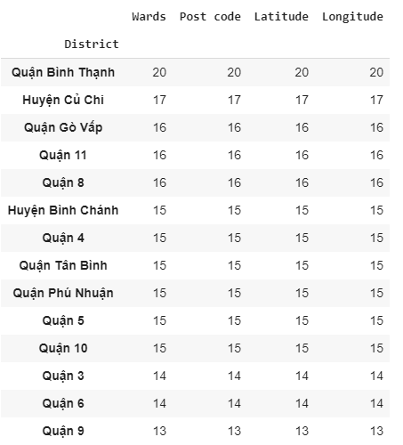
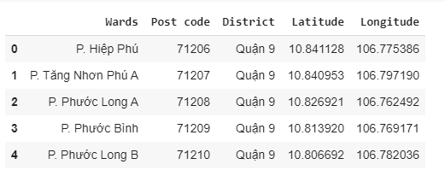
Information about post code, lat/lng of all district and neighborhoods (wards) in HCM city (lat/lng get from google API
Based on these information, I can get all venue in each neighborhoods from Foursquare API. This information will be feed to clustering method

Slide 5
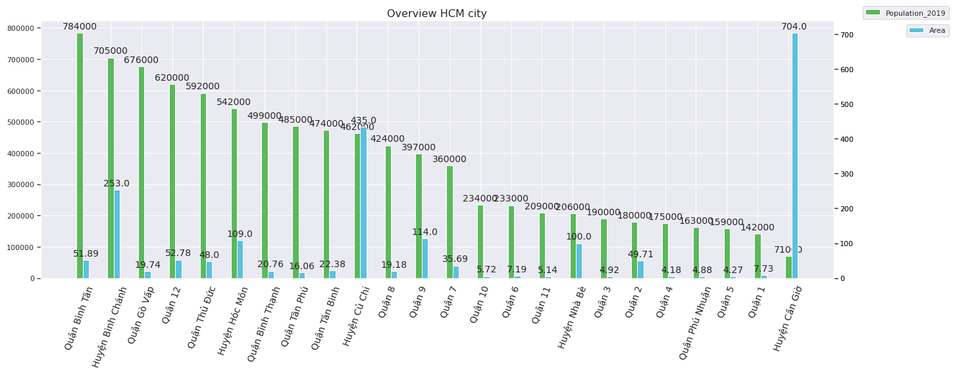
Overview population and area of all district in HCM city
My current location: District 9 has average population (397,000) and area (114 sqm)
Compare to another district

Slide 6
3. Methodology
In this project, I will find all venue in each neighborhoods based on foursquare API, this information will be used for clustering method. After that I will use K means to cluster similarity neighborhoods. I use two method to find optimize optimal value of cluster : elbow and silhouette_score. Optimal cluster number is very important to find similarity neighborhoods, so we will look closely to these method
Elbow method: find elbow value in chart (hard, depend on human visual)
Silhouette_score method: high score is better (easy to find optimal value but the speed is low)

Slide 7
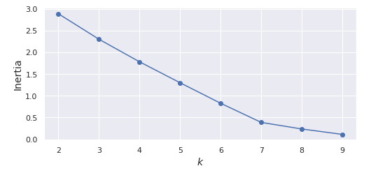
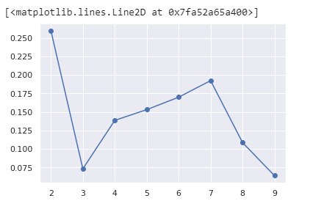
Elbow method: number of optimal cluster
Is 7 (elbow) – not easy to find by visual
Silhouette_score method: number
Of optimal cluster is 7 also (highest
Value in this chart – reject 2)

Slide 8
4. Results and Discussion
My current location: P. Phuoc Long B (Distric 9) is similar as many neighborhoods in district 2, 3, 7,8, 10, Phu Nhuan.... So I can decide go to these locations for my job and it will not effect to my life so much
Moreover, base on these information, I know the reason why these neighborhoods are similar: most common venues are coffee shop and restaurant. If I want to open the business in these location, I will consider coffee shop and restaurant first

Slide 9
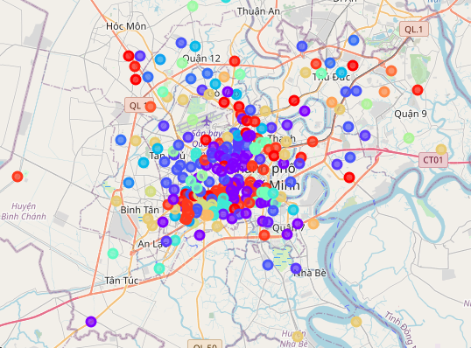
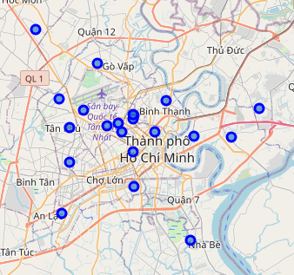
All 28 cluster neighborhoods in HCM city
All 21 neighborhoods that similar to my
Current neighborhoods: Phuoc Long B , district 9 (cluster 3)

Slide 10
5. Conclusion and Point for improvement
Purpose of this project to identify neighborhoods similar to my current neighborhoods (P. Phuoc Long B, Distric 9). These findings in this result can help me a lot to find similar neighborhoods for moving in the future
Point for improvement:
The foursquare API currently not supply enough information about some important venue each neighborhoods such as hospital, school, market...These things are very important to compare similarity of each neighborhoods. I think the reason is that users of foursquare are not much in VN

